Slide 1
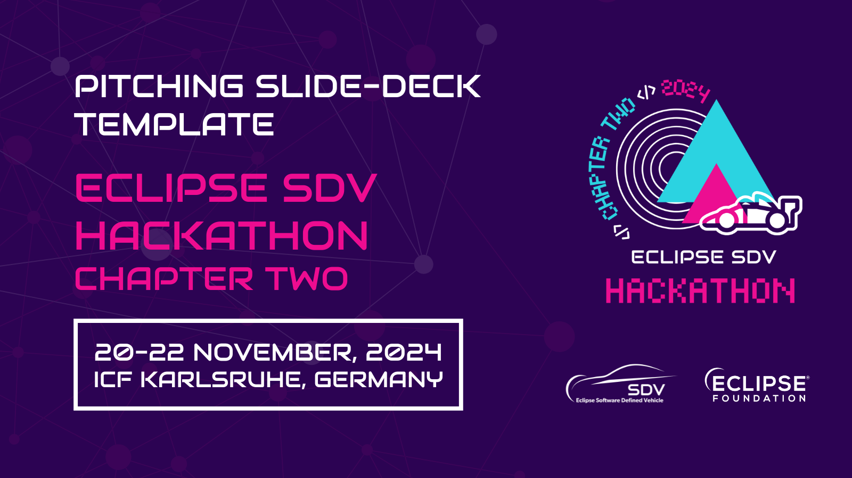

Slide 2


Pitching Session
. . .
XXX
20-22 November, Karlsruhe, Germany
An Eclipse SDV Event

Slide 3
The Team
Wanja Zaeske: Hardware geek (Sensors, display, coffee)
Richard Meinsen: Integration enthusiast (ThreadX + Zenoh Pico)
Halldor Stefansson: IoT tinkerer (MQTT)
Honorable mention:
Rainer Binder: Hardware provider + Security guard

Slide 4
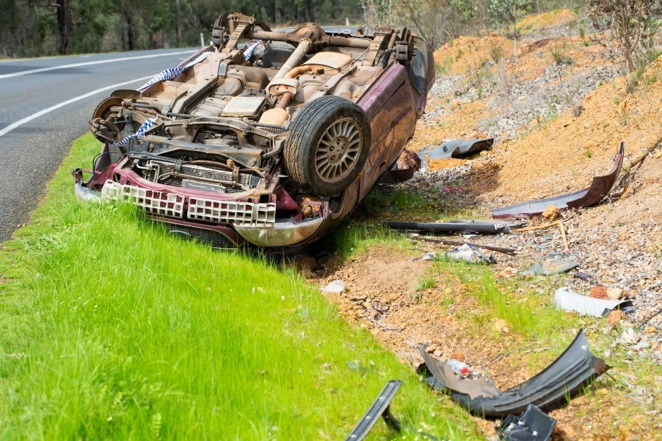
Car crash without help? What to do?
Car crashes can happen
anywhere, anytime.
But what if no one is around
to help?
... and you can’t reach your
phone to call for help?

Slide 5
Car crash without help? What to do?
Hours or days could pass before help arrives.
Delays in help can make injuries worse—or life-threatening

Slide 6


Solution
MXChip AZ3166 board
ThreadX
MQTT
... and zenoh in the future.

Slide 7
The Product / Service
ThreadX detects crash movements (sudden stop, car flips).
Sends an automatic alert via MQTT.
Notifies police and hospitals instantly

Slide 8
The Added Value
Fast emergency response!
Saves lives when the driver can't call for help.

Slide 9
The Market
[1] https://www.grandviewresearch.com/industry-analysis/automotive-internet-of-things-iot-market-report
The automotive IoT market is expected to grow at a CAGR of 11.8% from 2024 to 2030. ^{[1]}
SOS buttons or manual phone calls rely on the driver being conscious and capable.
A cost-effective, reliable crash detection and alert system that can integrate seamlessly with connected vehicles.
[1] https://www.grandviewresearch.com/industry-analysis/automotive-internet-of-things-iot-market-report

Slide 10
Business Model
Open-Source Solution: Accessible to developers and partners for easy integration.
B2B Partnerships: Collaborate with automakers, insurers, and fleet operators.
B2C Sales: Offer aftermarket devices for consumers.

Slide 11
Revenue Streams
Hardware Sales: Affordable open-source-enabled devices for vehicles.
Support: Paid customization and integration services.
Subscription Services: Premium features like analytics and notifications.

Slide 12
Business Plan
Build & Release: Launch the open-source core and hardware prototypes.
Engage Partners: Offer integration tools for automakers and insurers.
Consumer Launch: Market aftermarket devices globally.
Scale Revenue: Expand premium features and support services.

Slide 13
Thank You!
20-22 November, Karlsruhe, Germany
An Eclipse SDV Event

